Slide 1
AI Dermatologist
Melanoma Classification using Deep Learning

Slide 2
Understanding The Problem
Melanoma: A Looming Threat to Skin Cancer
Traditional Methods for Early Detection in Skin Cancer
Transforming Melanoma Diagnosis: The Power of Computer Vision and Deep Learning
The Dermoscopy Dilemma: Delayed Biopsy and Patient Hesitancy
Notes:
Skin cancer, with its various forms, poses a significant health concern worldwide. Among these, melanoma stands out as a particularly aggressive and life-threatening subtype. In the United States alone, nearly 100,000 new cases of melanoma are diagnosed annually, leading to around 8,000 deaths, making it one of the deadliest forms of skin cancer.
Early detection is crucial for effective treatment and improved survival rates, and traditionally, this has relied on visual inspection, clinical screening, dermoscopy analysis, and, in some cases, biopsies.
To detect melanoma, a doctor initially takes a dermoscopy image of the skin lesion. They analyze this image and then take a call if a biopsy should be done or not. It is possible that the doctor deems the skin lesion to be benign (not harmful) based on the dermoscopy image. Biopsy reports might also take upto 10 days. Furthermore, patients might be hesitant to opt for biopsy since they think it would be a waste of money if the report comes back negative.
The field of computer vision, powered by deep learning technologies, offers a promising avenue to revolutionize the diagnosis and management of melanoma. Deep learning and computer vision technologies can be leveraged to assist doctors to analyze the dermoscopy images more accurately. It also is a more time and cost efficient method for initial diagnosis before opting for biopsy.

Slide 3
Analyzing The Problem
Potential of AI in Melanoma Detection
Melanoma Statistics (2023)
Melanoma’s Impact on Skin Cancer Mortality
Global and U.S. Melanoma Prevalence
Notes:
In 2023, an estimated 97,610 new melanoma cases are expected in the United States.
An estimated 324,635 people were diagnosed with melanoma worldwide in 2020.
Melanoma in the U.S. is the fifth most common cancer for both men and women.
Melanoma accounts for only about 1% of all diagnosed skin cancers in the United States.
However, despite its relatively low occurrence, it is responsible for the majority of skin cancer-related deaths.
I hope u have understood the critical need for early detection and improved diagnostic methods.
A statement was made by the MIT researcher, which suggests that computer vision and deep neural networks can achieve accuracy comparable to expert dermatologists in assessing Suspicious Pigmented Lesions (SPLs).
Implementing such AI systems could lead to more rapid and accurate assessments, potentially enabling earlier treatment for melanoma.

Slide 4
Abstract: Literature Review
ACCESSIBILITY
OBJECTIVE
DATASET
EVALUATION
METHODOLOGY
Notes:
1.Objective: Explore the integration of computer vision techniques in healthcare, using deep convolutional neural networks to differentiate malignant melanoma from benign melanoma.
2. Dataset: Utilize a dataset of dermoscopic images of benign and malignant moles provided by the ISIC (International Skin Imaging Collaboration).
3. Methodology: Build a convolutional neural network using TensorFlow (Keras) and examine various architectures to find a suitable fit for the use case.
4. Evaluation: Assess the performance of the model in classifying melanoma and emphasize its potential for providing a rapid and cost-effective diagnosis, addressing the current issues of time-consuming and expensive diagnostics.
5. Accessibility: Present a user-friendly web app interface for accessible use, making the technology available to a wider audience.

Slide 5
Technologies Involved
FRONT-END
MODEL
BACK-END
IMAGE PROCESSING
Notes:
Model: Tensorflow (Keras)
Image processing: Numpy, Opencv (cv2)
Frontend: HTML, CSS, JS
Backend: Flask

Slide 6
Dataset
Contents of Dataset
https://www.isic-archive.com/
Role of Public Dermatology Image Archives
I.S.I.C
Notes:
Dataset used to train the model is provided by ISIC (International Skin Imaging Collaboration).
They have a large and expanding open-source public-access archive of skin images that serves as a public resource for teaching, research, and the development and testing of diagnostic artificial intelligence algorithms
Dataset consists of 9600 images for training the model and 1000 images for evaluation of model.

Slide 7
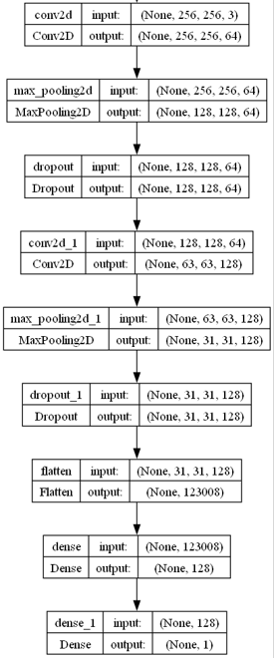
Procedure
The Procedure is divided into 3 Major steps:
Initial model training
Web app development and model integration
Exploration and testing various other architectures, like ImageNet and ResNet architectures.
Notes:
Initial Model Training
Load melanoma dataset
Split dataset into train and test sets in 80:20 ratio
Reshape images in dataset to 256x256 dimensions
Normalize pixel values
Define model architecture
Train the model on the loaded dataset by correctly defining the loss functions, optimizer algorithms and metrics to be calculated
Calculate accuracy of model on test set
Save model with .keras extension

Slide 8
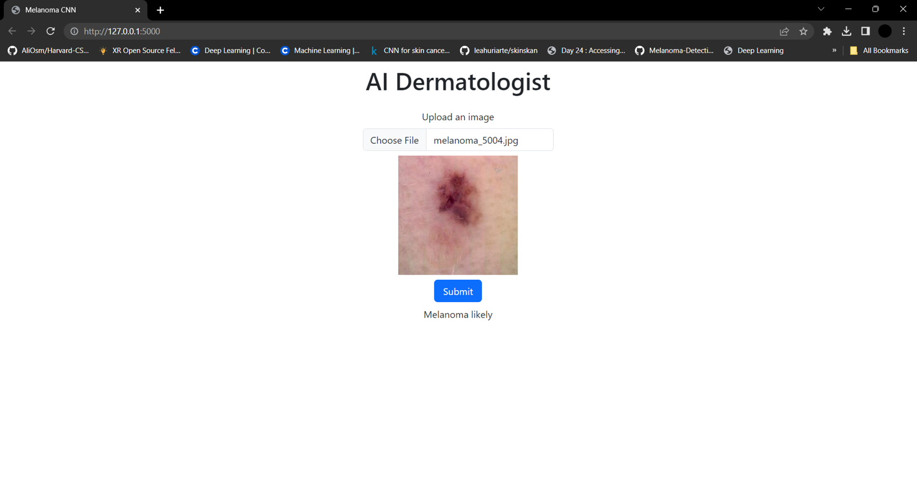
Notes:
Web app development and model integration
Create UI with upload image widget and an upload button
Once button is clicked, uploaded image is sent to the backend at the “/upload” route
The saved “model.keras” file is loaded
Uploaded image is normalized and reshaped to 256x256 size.
Image is passed through neural network and probability that the mole is malignant is calculated
The predicted output is updated on the screen

Slide 9
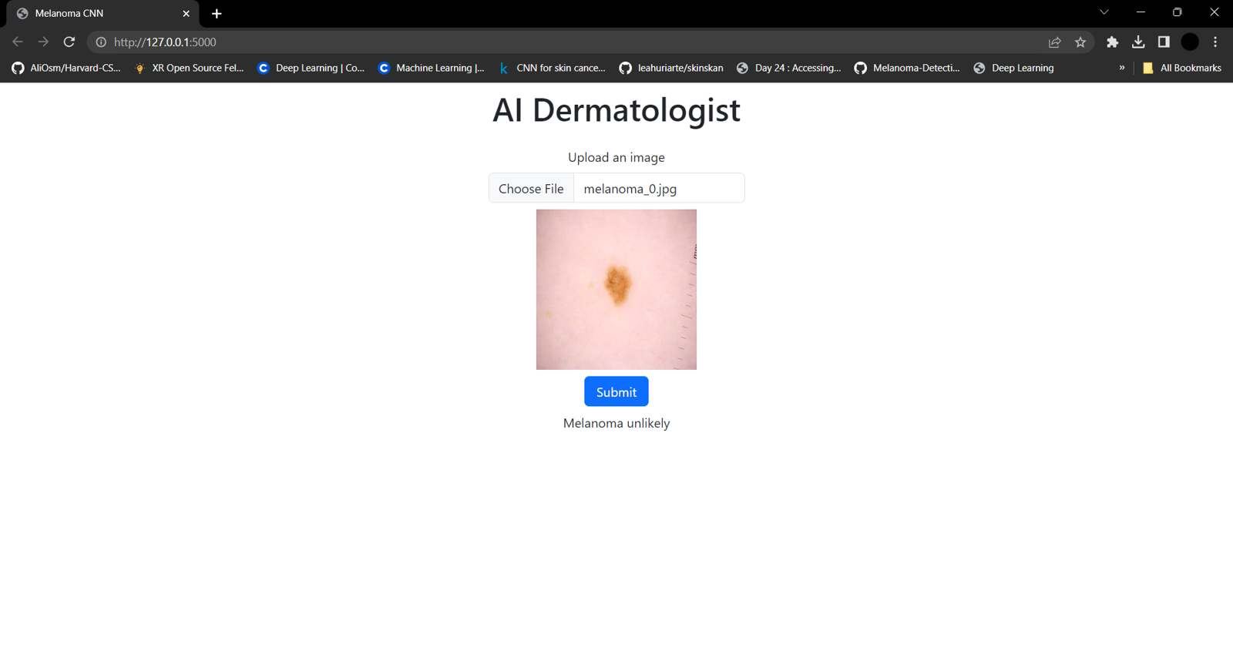
Notes:
Exploration and testing various other architectures:
In the field of skin lesion analysis, deep learning has delivered remarkable results for tasks such as lesion segmentation, lesion classification, and medical attribute detection. Since 2015, convolutional neural networks (CNNs) have been the gold standard for melanoma classification. Typically, models are trained using transfer learning, where an ImageNet pre-trained CNN is adapted for melanoma data. However, as the number of CNN architectures continues to grow, selecting the right one becomes a challenge for researchers.
In addition to creating a neural network from the ground up, we will also investigate fine-tuning pre-trained CNN models, such as ImageNet and ResNet, to explore if we can achieve even better performance.

Slide 10
Scalability
Collaboration and Data Expansion
Scalability in Skin Cancer Classification
Transfer Learning for Enhanced Scalability
Multi-Class Classification Capabilities
Notes:
Scalability in Skin Cancer Classification
Highlighting the adaptability of the AI Dermatologist model beyond melanoma to various other skin conditions, such as Basal cell carcinoma, vascular lesions, actinic keratosis, and more.
Discuss the potential for the model to serve as a versatile tool for a broader range of skin problem classification.
Multi-Class Classification Capabilities
Describe the AI Dermatologist's ability to perform multi-class classification, enabling the identification and differentiation of different types of skin lesions within the same dataset.
Emphasize the model's capacity to address a diverse array of skin conditions in a single diagnostic system.
Transfer Learning for Enhanced Scalability
Explain the use of transfer learning techniques, which allow the model to leverage knowledge gained from one skin condition to improve the accuracy and efficiency of diagnosing other skin problems.
Discuss how transfer learning can expedite the development of diagnostic AI algorithms for new skin conditions.
Collaboration and Data Expansion
Highlight the potential for collaboration with dermatologists and medical institutions to continually expand the model's dataset with diverse skin lesions.
Emphasize that a larger, more varied dataset can enhance the model's ability to classify an even wider range of skin conditions.
Customization and Accessibility
Discuss the option to customize the AI Dermatologist to address specific skin conditions or requirements relevant to particular regions or populations.
Highlight the accessibility and adaptability of the model to cater to the unique needs of healthcare providers and patients worldwide.

Slide 11
References
A. Naeem, M. S. Farooq, A. Khelifi and A. Abid, "Malignant Melanoma Classification Using Deep Learning: Datasets, Performance Measurements, Challenges and Opportunities," in IEEE Access, vol. 8, pp. 110575-110597, 2020, doi: 10.1109/ACCESS.2020.3001507.
F. Perez, S. Avila and E. Valle, "Solo or Ensemble? Choosing a CNN Architecture for Melanoma Classification," 2019 IEEE/CVF Conference on Computer Vision and Pattern Recognition Workshops (CVPRW), Long Beach, CA, USA, 2019, pp. 2775-2783, doi: 10.1109/CVPRW.2019.00336.

Slide 12
Thank you everyone for your time.
Please feel free to ask any questions. 😄

